Slide 1

MINI PROJECT ON voice based email for blind people
Presented By
Kishor N
Dheeraj S
Under the Guidance of:
Dr.Basavesha D M.Tech.,Ph.D.,MISTE
HOD ,Dept. of CSE

Slide 2
contents
Introduction
Objectives
Problem Statement
Existing System
System Architecture
Results
Conclusion
References

Slide 3
introduction
The Voice-Based Email System leverages advanced speech recognition and text-to-speech technologies to offer a seamless, auditory email experience. Users can compose, send, and check their emails through simple voice commands, eliminating the need for traditional screen-based interactions. This system is built on Python and integrates with popular email services to ensure reliable and secure communication.
Voice Command Input: Users can dictate their emails and provide commands through their voice, making the system accessible and easy to use.
Speech Recognition: The system accurately interprets spoken words and converts them into text for composing and sending emails.
Text-to-Speech Output: Incoming emails are read aloud to the user, providing a complete auditory experience.
Email Management: Users can manage their inbox, check for new messages, and listen to the content of their emails without needing to interact with a screen.

Slide 4
Objectives
The primary objective of the Voice-Based Email System for blind and visually impaired individuals is to create an accessible and intuitive communication tool that allows users to manage their email through voice commands. The system aims to integrate accurate speech recognition for composing and sending emails, alongside text-to-speech technology to read incoming messages aloud. By ensuring secure communication and real-time email management, the project seeks to empower users with greater independence and ease in their digital interactions. Additionally, the system is designed to be compatible with popular email services, providing a seamless experience for users from diverse linguistic backgrounds.

Slide 5
Problem statement
Challenges for Blind Users:
Difficulty accessing and managing email due to reliance on visual interfaces.
Need for Accessibility:
An accessible solution is needed for auditory interaction with email systems.
Project Aim:
Develop a Voice-Based Email System using speech recognition and text-to-speech technologies.
Objective:
Enable blind users to manage emails through voice commands, enhancing communication capabilities and promoting digital independence.

Slide 6
Existing system
Primarily designed for sighted users, making it hard for visually impaired users to compose, send, and read emails.
Visual Dependency:
Interfaces are designed primarily for sighted users, requiring visual interaction.
Limited Voice Interaction:
Few systems offer comprehensive voice command capabilities for email management.
Manual Input Challenges:
Difficulty composing and editing emails using traditional keyboard and mouse inputs.

Slide 7
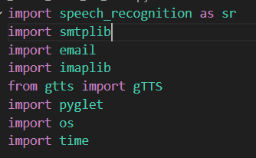
Language Used : Python

Slide 8
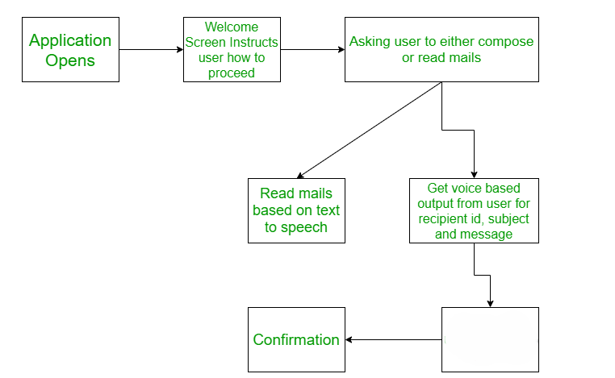
System architecture
Sends mails using Python API

Slide 9
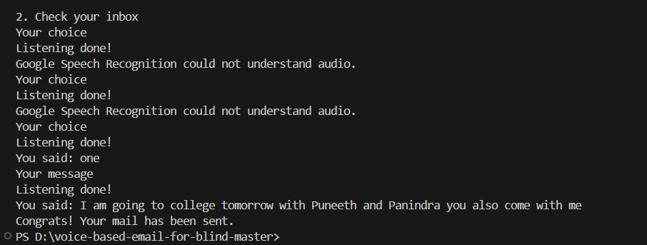
Results The page of the application that displays real time email sending to provided mail id.

Slide 10
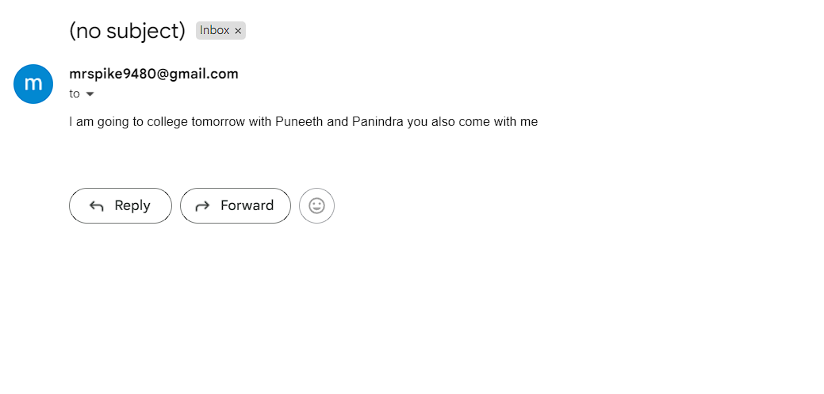
EMAIL RECIVED CONFORMATION

Slide 11
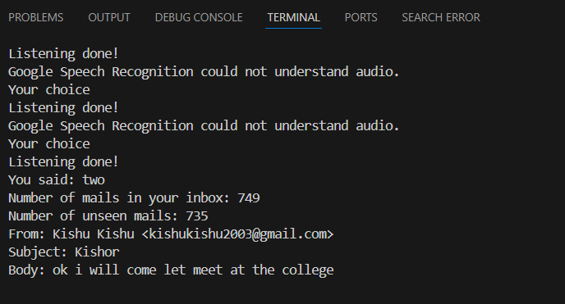
CHECK YOUR INBOX

Slide 12
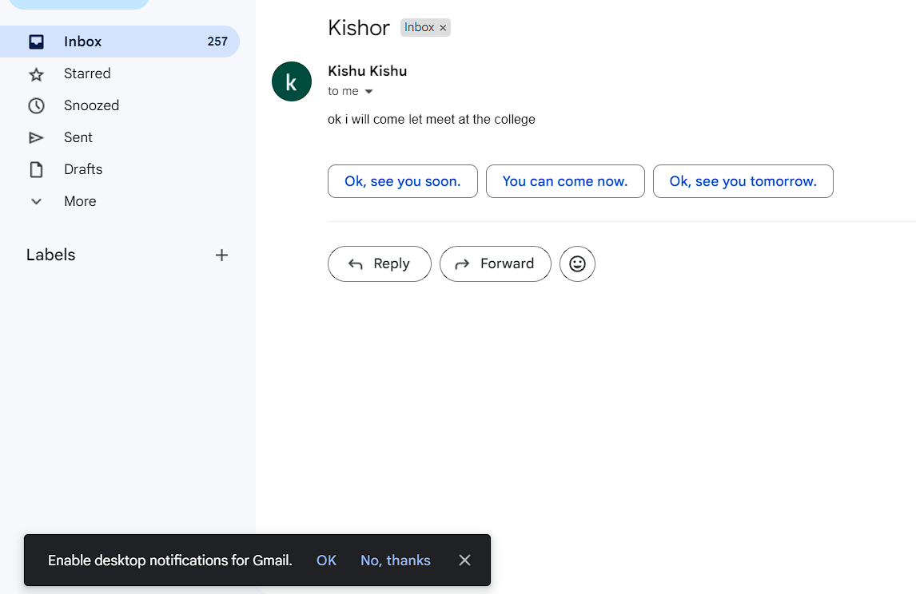
CONFORMATION OF MAIL HAVE BEEN READ

Slide 13
conclusion
In conclusion, developing a voice-based email system for blind individuals represents a significant step forward in enhancing accessibility and independence. This project addresses the pressing need for more inclusive communication tools by leveraging voice recognition technology to create a user-friendly and efficient email solution. By integrating with existing assistive technologies and offering customization options, this system can be tailored to meet the unique needs of each user, promoting a more personalized experience.

Slide 14
references
Lazar, J., Feng, J. H., & Hochheiser, H. (2017). Research Methods in Human-Computer Interaction. Morgan Kaufmann. Norman, D. A., & Nielsen, J. (2018). The Design of Everyday Things: Revised and Expanded Edition. Basic Books.
World Wide Web Consortium (W3C). (2018). Web Content Accessibility Guidelines (WCAG) 2.1. Retrieved from https://www.w3.org/TR/WCAG21/
National Federation of the Blind (NFB). https://www.nfb.org/
American Foundation for the Blind (AFB). https://www.afb.org/
Google Voice Assistant: https://assistant.google.com/

Slide 15
Thank you

